Slide 1

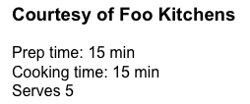


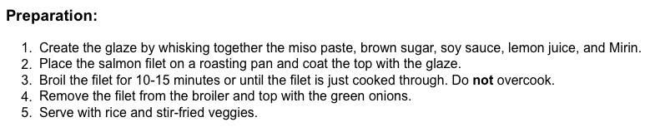
Salmon Recipe
Awesome Hause logo
Use some fancy font here please!!
Finished recipe
Lemon
Green onion

